Slide 1
PYTHON

Slide 2
Python List
Lists are used to store multiple items in a single variable.
In Python programming, a list is created by placing all the items (elements) inside square brackets [], separated by commas.
It can have any number of items and they may be of different types (integer, float, string etc.).
# empty list
my_list = []
# list of integers
my_list = [1, 2, 3]
# list with mixed data types
my_list = [1, "Hello", 3.4]

Slide 3
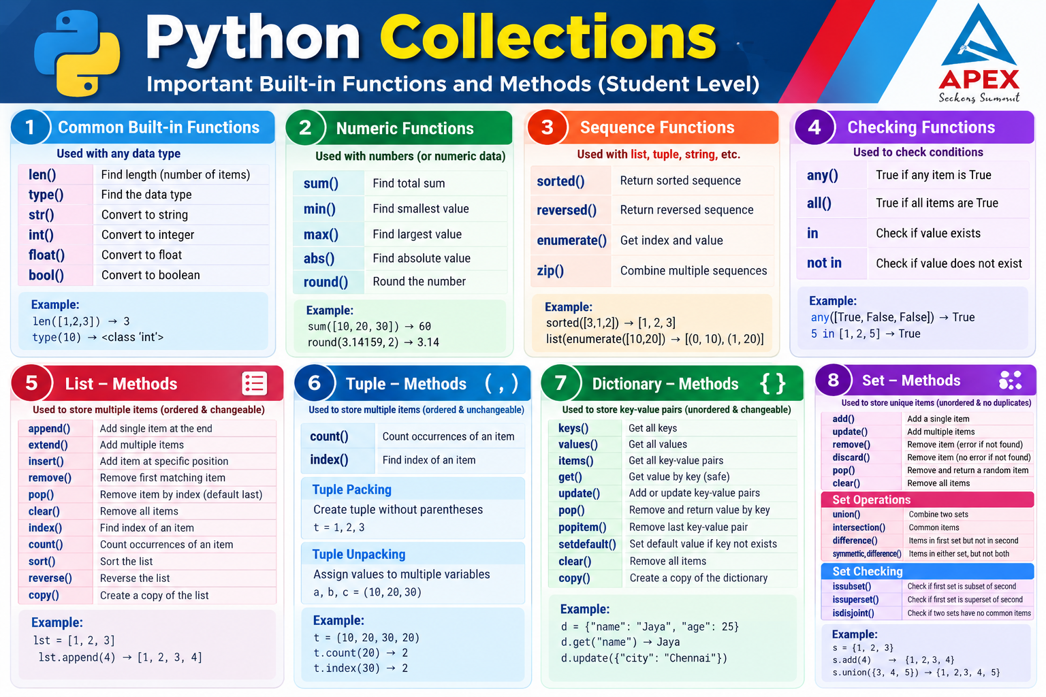

Slide 4
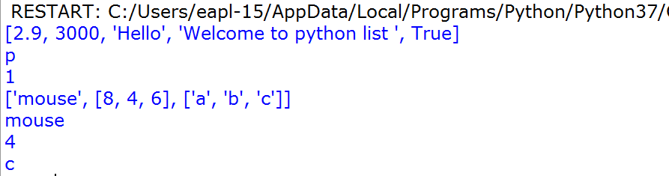
#multiple datatype assign
n_list=[2.9,3000,'Hello',"Welcome to python list ", True]
print(n_list)
# Nested List Example1
n_list = ["Happy", [2, 0, 1, 5]]
# Nested indexing
print(n_list[0][3])
print(n_list[1][2])
# Nested List Example2
my_list = ["mouse", [8, 4, 6], ['a','b','c']]
print(my_list)
print(my_list[0])
# Nested indexing
print(my_list[1][1])
print(my_list[2][2])

Slide 5
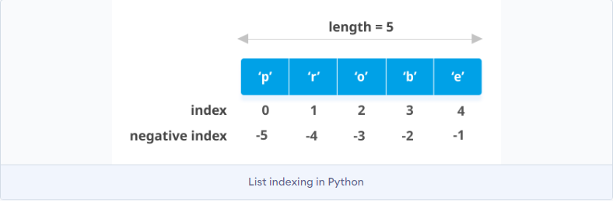
Negative indexing
Python allows negative indexing for its sequences. The index of -1 refers to the last item, -2 to the second last item and so on.
# Negative indexing in lists
my_list = ['p','r','o','b','e']
print(my_list[-1])
print(my_list[-5])
Output:
e
p

Slide 6

list using the append() method or add several items using extend() method.
# Appending and Extending lists in Python
odd = [1, 3, 5]
odd.append(7)
print(odd)
odd.extend([9, 11, 13])
print(odd)

Slide 7
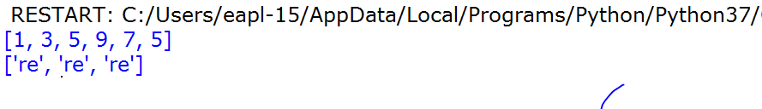
+ operator to combine two lists.
* operator repeats a list for the given number of times.
# Concatenating and repeating lists
odd = [1, 3, 5]
print(odd + [9, 7, 5])
print(["re"] * 3)

Slide 8
Python- Delete
Pop()
Del Operator
Remove()

Slide 9
List Length & Remove
thislist = ["apple", "banana", "cherry"]
print(len(thislist))
Remove Specified Item:
thislist = ["apple", "banana", "cherry"]
thislist.remove("banana")
print(thislist)
Output:
['apple', 'cherry']

Slide 10
Python - Loop Lists
thislist = ["apple", "banana", "cherry"]
for x in thislist:
print(x)
Output:
apple
banana
cherry
Using a While Loop
thislist = ["apple", "banana", "cherry"]
i = 0
while i < len(thislist):
print(thislist[i])
i = i + 1

Slide 11
Python - Sort Lists
List objects have a sort() method that will sort the list alphanumerically, ascending, by default:
thislist = ["orange", "mango", "kiwi", "pineapple", "banana"]
thislist.sort()
print(thislist)
Output:['banana', 'kiwi', 'mango', 'orange', 'pineapple']
thislist = [100, 50, 65, 82, 23]
thislist.sort()
print(thislist)
Outpu: [23, 50, 65, 82, 100]

Slide 12
Sort Descending
To sort descending, use the keyword argument reverse = True:
thislist = ["orange", "mango", "kiwi", "pineapple", "banana"]
thislist.sort(reverse = True)
print(thislist)
Output:['pineapple', 'orange', 'mango', 'kiwi', 'banana']
thislist = [100, 50, 65, 82, 23]
thislist.sort(reverse = True)
print(thislist)
Output:[100, 82, 65, 50, 23]

Slide 13
Python - Copy Lists
thislist = ["apple", "banana", "cherry"]
mylist = thislist.copy()
print(mylist)
Output:['apple', 'banana', 'cherry']
Another way to make a copy is to use the built-in method list().
Make a copy of a list with the list() method:
thislist = ["apple", "banana", "cherry"]
mylist = list(thislist)
print(mylist)
Output:['apple', 'banana', 'cherry']

Slide 14
Python-insert()
fruits = ['apple', 'banana', 'cherry']
fruits.insert(1, "orange")
print(fruits)
Output:['apple', 'orange', 'banana', 'cherry']

Slide 15
Remove Specified Index
The pop() method removes the specified index.
thislist = ["apple", "banana", "cherry"]
thislist.pop(1)
print(thislist)
Output:['apple', 'cherry']
thislist = ["apple", "banana", "cherry"]
thislist.pop()
print(thislist)
Output:['apple', 'banana']

Slide 16
del keyword also removes the specified index:
thislist = ["apple", "banana", "cherry"]
del thislist[0]
print(thislist)
Output: ['banana', 'cherry']
Clear the List
Clear the list content:
thislist = ["apple", "banana", "cherry"]
thislist.clear()
print(thislist)
output: [ ]

Slide 17
Python List count() Method
fruits = ["apple", "banana", "cherry","apple"]
x = fruits.count("apple")
print(x)
Output: 2
fruits = [1, 4, 2, 9, 7, 8, 9, 3, 1]
x = fruits.count(9)
print(x)
Output: 2

Slide 18
list copy() method
# Program to demonstrate
lst = [10, 20, 30, 40]
# Create a copy of the list
new_lst = lst.copy()
print("Original List :", lst)
print("Copied List :", new_lst)
Original List : [10, 20, 30, 40]
Copied List : [10, 20, 30, 40]

Slide 19
list index() method
lst = [10, 20, 30, 40, 50]
value = 30
position = lst.index(value)
print("List :", lst)
print("Value :", value)
print("Index :", position)
List : [10, 20, 30, 40, 50]
Value : 30
Index : 2

Slide 20
Python- Delete
Pop()
Del Operator
Remove()

Slide 21
Python- pop
index of the element you want, you can use pop:
>>> t = ['a', 'b', 'c']
>>> x = t.pop(1)
>>> print (t)
['a', 'c']
>>> print (x)
b

Slide 22
Python – del operator
>>> t = ['a', 'b', 'c']
>>> del t[1]
>>> print (t)
['a', 'c']

Slide 23
Python- remove
the element you want to remove (but not the index), you can use remove:
>>> t = ['a', 'b', 'c']
>>> t.remove('b')
>>> print (t)
['a', 'c']

Slide 24
Python- remove
the element you want to remove (but not the index),use remove:
>>> t = ['a', 'b', 'c']
>>> t.remove('b')
>>> print t
['a', 'c']

Slide 25
Python- remove all
To remove more than one element, use del with a slice index:
>>> t = ['a', 'b', 'c', 'd', 'e', 'f']
>>> del t[1:5]
>>> print (t)
['a', 'f']

Slide 26
Python – list - Built-in-function
>>> nums = [3, 41, 12, 9, 74, 15]
>>> print len(nums)
6
>>> print max(nums)
74
>>> print min(nums)
3
>>> print sum(nums)
154
>>> print sum(nums)/len(nums)
25

Slide 27

Python-List and String
To convert from a string to a list of characters, you can use list:
>>> s = 'spam'
>>> t = list(s)
>>> print (t)
['s', 'p', 'a', 'm']

Slide 28
Python - Split
break a string into words, can use the split method:
>>> s = 'pining for the fjords'
>>> t = s.split()
>>> print (t)
['pining', 'for', 'the', 'fjords']
>>> print t[2]
the

Slide 29
Python - uses a hyphen as a delimiter:
http://www.opentextbooks.org.hk/ditatopic/6750
>>> s = 'spam-spam-spam'
>>> delimiter = '-'
>>> s.split(delimiter)
['spam', 'spam', 'spam']

Slide 30
Python – list - Built-in-function
>>> nums = [3, 41, 12, 9, 74, 15]
>>> print len(nums)
6
>>> print max(nums)
74
>>> print min(nums)
3
>>> print sum(nums)
154
>>> print sum(nums)/len(nums)
25

Slide 32
Python Tuples
In Python, a tuple is similar to List except that the objects in tuple are immutable.
Only the difference is that List uses square bracket and tuple uses parenthesis.
Tuples are enclosed in parenthesis and cannot be changed(immutable).
You cannot delete or add elements in a tuple, once it is created.

Slide 33
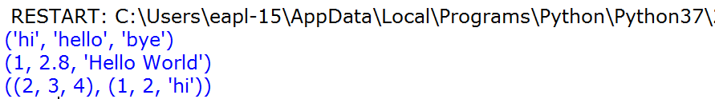
Creating tuple
# tuple of strings
my_data = ("hi", "hello", "bye")
print(my_data)
# tuple of int, float, string
my_data2 = (1, 2.8, "Hello World")
print(my_data2)
# tuples inside another tuple
# nested tuple
my_data4 = ((2, 3, 4), (1, 2, "hi"))
print(my_data4)

Slide 34
Accessing tuple elements using positive indexes
# tuple of strings
my_data = ("hi", "hello", "bye")
# displaying all elements
print(my_data)
# accessing first element
# prints "hi"
print(my_data[0])
# accessing third element
# prints "bye"
print(my_data[2])

Slide 35
Negative indexes in tuples
my_data = (1, 2, "Kevin", 8.9)
# accessing last element
# prints 8.9
print(my_data[-1])
# prints 2
print(my_data[-3])

Slide 36
Accessing elements from nested tuples
my_data = (1, "Steve", (11, 22, 33))
# prints 'v'
print(my_data[1][3])
# prints 22
print(my_data[2][1])

Slide 37
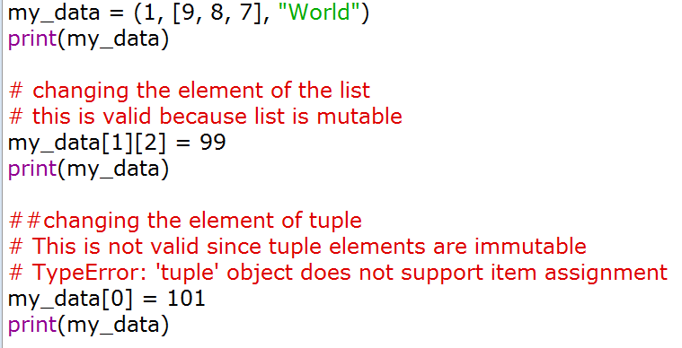
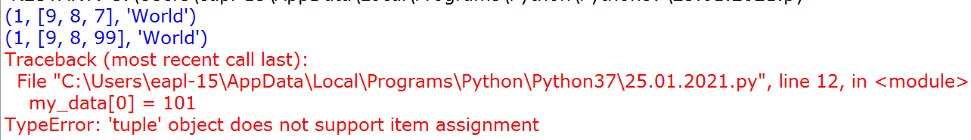
Changing the elements of a tuple

Slide 38
Delete operation on tuple
tuple elements are immutable which also means that we cannot delete the elements of a tuple.
my_data = (1, 2, 3, 4, 5, 6)
print(my_data)
# not possible
# error
# del my_data[2]
# deleting entire tuple is possible
del my_data
# not possible
# error
# because my_data is deleted
# print(my_data)

Slide 39
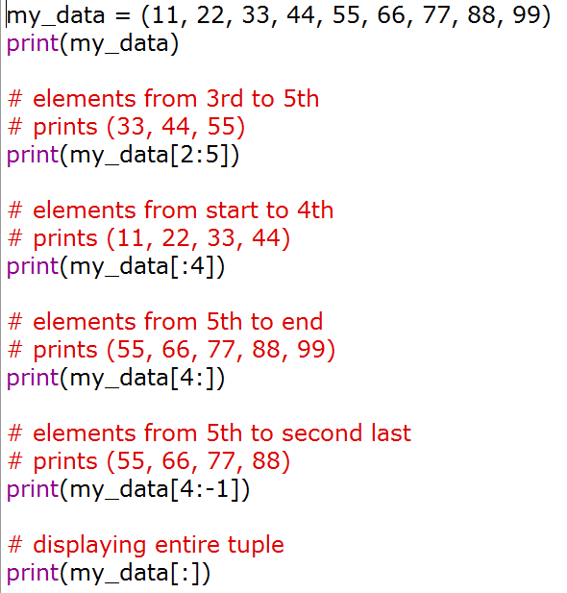
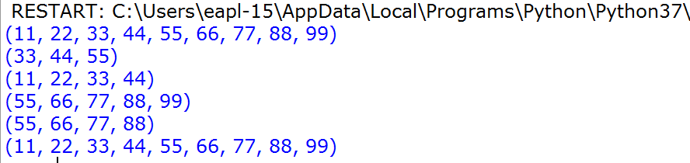
Slicing operation in tuples

Slide 40
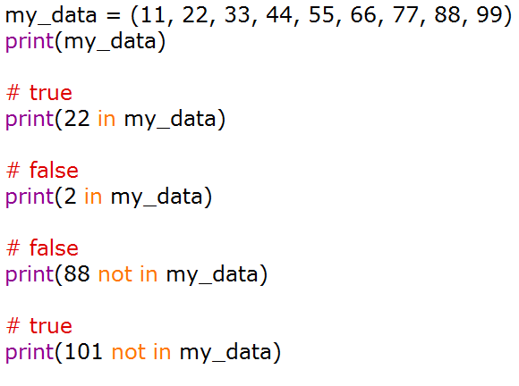
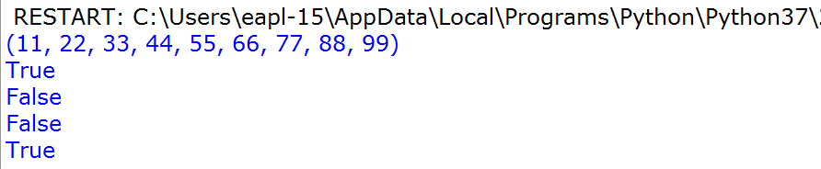
Membership Test in Tuples

Slide 41
Iterating a tuple
# tuple of fruits
my_tuple = ("Apple", "Orange", "Grapes", "Banana")
# iterating over tuple elements
for fruit in my_tuple:
print(fruit)

Slide 42
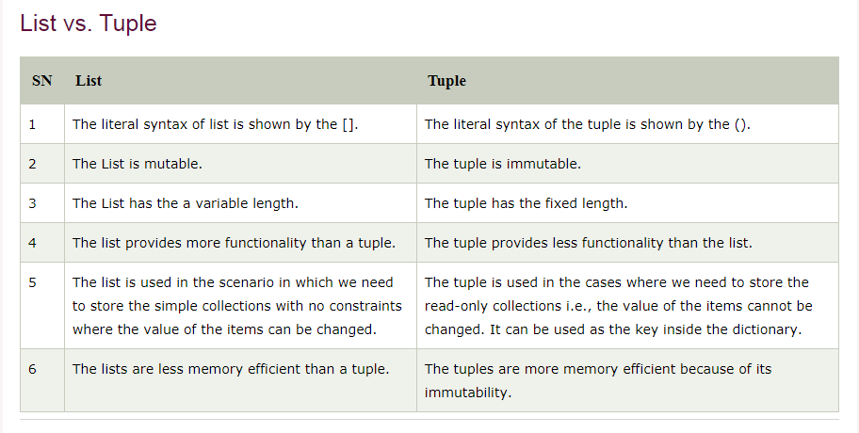

Slide 43
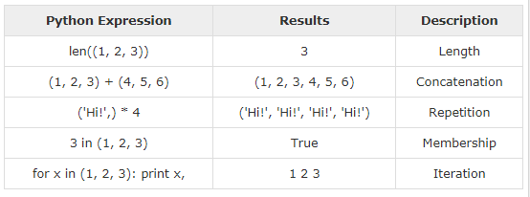
Basic Tuples Operations

Slide 44

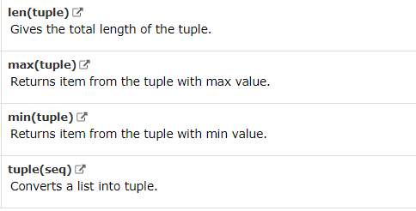
Python -Built-in Tuple Functions

Slide 45

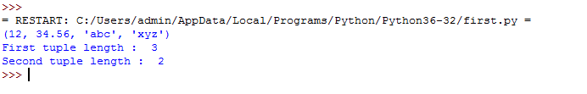
Python Tuple len() Method

Slide 46
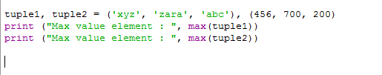

Python Tuple max() Method

Slide 47
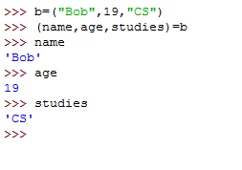
Python – Tuple assignment
Python has a very powerful tuple assignment feature that allows a tuple of variables on the left of an assignment to be assigned values from a tuple on the right of the assignment.
In tuple packing, the values on the left are ‘packed’ together in a tuple:
>>> b = ("Bob", 19, "CS") # tuple packing
In tuple unpacking, the values in a tuple on the right are ‘unpacked’ into the variables/names on the right:
#tuple un-packing

Slide 49
Python Dictionary
Dictionary is a collection which works on a key-value pair.
An item has a key and a corresponding value that is expressed as a pair
Dictionaries are enclosed by curly braces ({}) and values can be retrieved by
square bracket([]).
values can be of any data type and can repeat, keys must be of immutable type
(string, number or tuple with immutable elements) and must be unique.

Slide 50
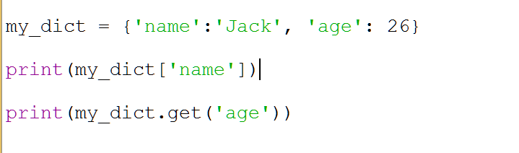
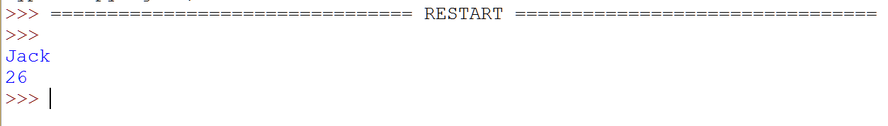
Accessing Elements from Dictionary

Slide 51
# 1. Empty dictionary
my_dict = {}
print("1. Empty Dictionary:", my_dict)
# 2. Dictionary with integer keys
my_dict = {1: 'apple', 2: 'ball'}
print("2. Integer Keys:", my_dict)
# 3. Dictionary with mixed keys
my_dict = {'name': 'John', 1: [2, 4, 3]}
print("3. Mixed Keys:", my_dict)
# 4. Using dict()
my_dict = dict({1: 'apple', 2: 'ball’})
print("4. Using dict():", my_dict)
# 5. From sequence (list of tuples)
my_dict = dict([(1, 'apple'), (2, 'ball')])
print("5. From Sequence:", my_dict)
You are converting an already existing dictionary into a dictionary
You are creating a dictionary from a list of tuples (pairs)
pairs = [(1, 'apple'), (2, 'ball')]
my_dict = dict(pairs)
print(my_dict)

Slide 52
1. Empty Dictionary: {}
2. Integer Keys: {1: 'apple', 2: 'ball'}
3. Mixed Keys: {'name': 'John', 1: [2, 4, 3]}
4. Using dict(): {1: 'apple', 2: 'ball'}
5. From Sequence: {1: 'apple', 2: 'ball'}

Slide 53
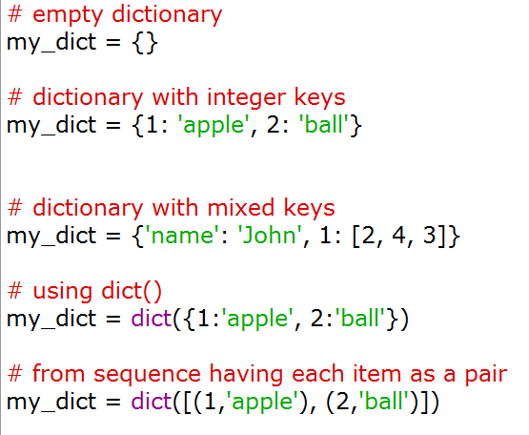
dictionary using the built-in dict() function.

Slide 54
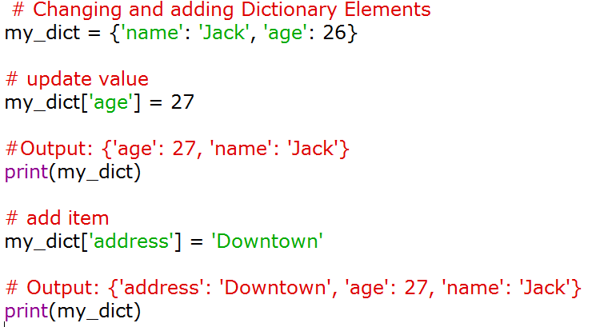

Changing and Adding Dictionary elements
Dictionaries are mutable. We can add new items or change the value of existing items using an assignment operator.
Key is already present, then the existing value gets updated.

Slide 55
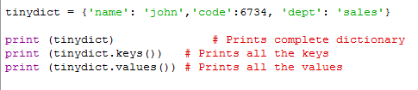
Python – Dictionaries Example

Slide 56
Removing elements from Dictionary
remove a particular item in a dictionary by using the pop() method.
This method removes an item with the provided key and returns the value.
popitem() method can be used to remove and return an arbitrary (key, value) item pair from the dictionary.
items can be removed at once, using the clear() method.
del keyword to remove individual items or the entire dictionary itself.

Slide 57
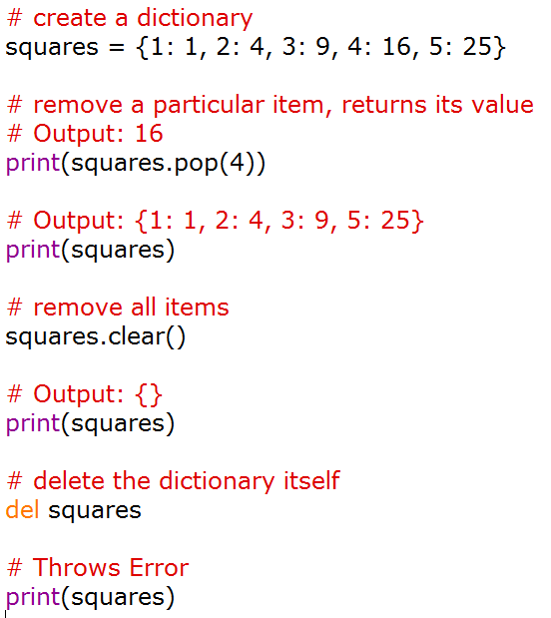
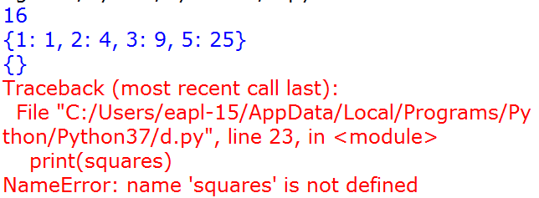

Slide 58
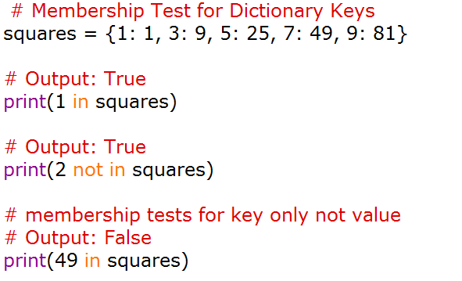


Slide 59
Python Dictionary

Slide 60
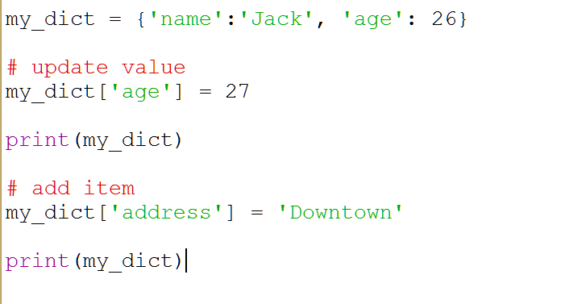
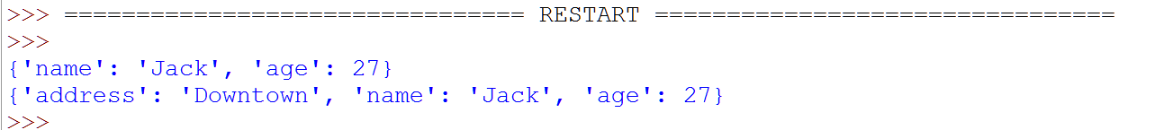
How to change or add elements in a dictionary?

Slide 62
Python Sets
What is a set in Python?
A set is an unordered collection of items.
Every element is unique (no duplicates)
It is written using { }
the set itself is mutable. We can add or remove items from it.

Slide 63
Python Sets
# set of integers
my_set = {1, 2, 3}
print(my_set)
# set of mixed datatypes
my_set = {1.0, "Hello", (1, 2, 3)}
print(my_set)
Output:
{1, 2, 3}
{'Hello', 1.0, (1, 2, 3)}

Slide 64
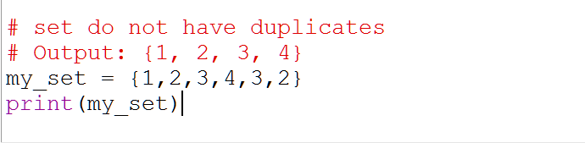
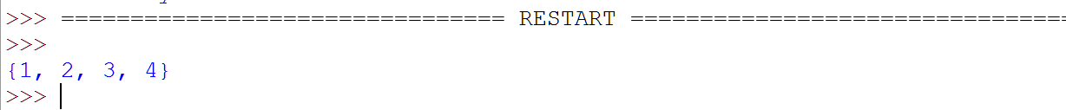
Python Sets
Creating a Set
fruits = {"Apple", "Banana", "Mango"}
print(fruits)
Adding Element
my_set = {1, 2, 3}
my_set.add(4)
print(my_set)
{1, 2, 3, 4}

Slide 65
Removing Element
my_set = {1, 2, 3}
my_set.remove(2)
print(my_set) {1, 3}
From List to Set
numbers = [1, 2, 2, 3, 4]
my_set = set(numbers)
print(my_set)
{1, 2, 3, 4}

Slide 66
Python Set union() Method
The set.union() method returns a new set with distinct elements from all the given sets.
nums1 = {1, 2, 2, 3, 4, 5}
nums2 = {4, 5, 6, 7, 7, 8}
distinct_nums = nums1.union(nums2)
print("The union of two sets is: ", distinct_nums)
Output
The union of two sets is: {1, 2, 3, 4, 5, 6, 7, 8}

Slide 67
Python Set intersection() Method
nums1 = {1, 2, 2, 3, 4, 5}
nums2 = {4, 5, 6, 7, 7, 8}
common_nums = nums1.intersection(nums2)
print("The intersection of two sets is:", common_nums)
The intersection of two sets is: {4, 5}

Slide 68
Python Set difference() Method
The set.difference() method returns the new set with the unique elements that are not in the other set passed as a parameter
nums1 = {1, 2, 2, 3, 4, 5}
nums2 = {4, 5, 6, 7, 8, 8}
nums3 = nums1.difference(nums2)
nums4 = nums2.difference(nums1)
print("nums1 - nums2: ", nums3)
print("nums2 - nums1: ", nums4)
Output
nums1 - nums2: {1, 2, 3}
nums2 - nums1: {8, 6, 7}
https://www.tutorialsteacher.com/python/set-difference

Slide 69
Set Operations
A = {1, 2, 3, 4}
B = {3, 4, 5, 6}
print(A | B) # Union
print(A & B) # Intersection
print(A - B) # Difference
Output:
{1, 2, 3, 4, 5, 6}
{3, 4}
{1, 2}

